Slide 1
Oscillator Circuits

Slide 2
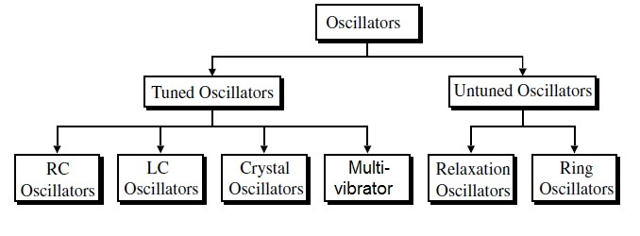
Oscillator Classification

Slide 3
RC Phase shift oscillator
F=1/(2π$\sqrt{6}RC)$
Since the configuration of the amplifier is inverting, the phase shift network has to give a phase shift of 180 degrees. This is required so that the feedback at the input will become positive.

Slide 4
Weinbridge Oscillator
Resistors R1 and R2 and capacitors C1 and C2 form the frequency-adjustment elements, while resistors R3 and R4 form part of the feedback path. The op-amp output is connected as the bridge input at points a and c. The bridge circuit output at points b and d is the input
to the op-amp.
Wien bridge oscillator circuit is a popular audio frequency oscillator. This is mostly used because of its important features. This circuit is free from the circuit fluctuations and the ambient temperature.

Slide 5
Tuned Oscillators

Slide 6
Colpitt’s Oscillator
The op-amp provides the basic amplification needed while the oscillator frequency is set by an LC feedback network of a Colpitts configuration.

Slide 7
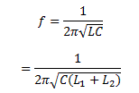
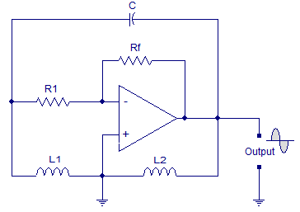
Hartley’s Oscillator

